Slide 1
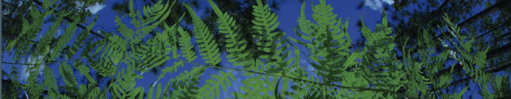

02- Data Cleaning
Shelly Gaynor
University of Florida

Slide 2
Data cleaning
02_Data_Cleaning.R
0. Exploring the dataset
Taxonomic Harmonization
Clean localities
Precision
Remove impossible points
Most common coordinate: 0.00, 0.00
Cultivated zones, botanical gardens, etc
Flag and Filter Cultivated Records
Duplicate Removal
Spatial deduplication
Spatial thinning
Visualize
Save cleaned.csv
- REPEAT -

Slide 3
Data cleaning
02_Data_Cleaning.R
0. Exploring the dataset
B. Taxonomic Harmonization
C. Clean localities
Precision
Remove impossible points
Most common coordinate: 0.00, 0.00
Cultivated zones, botanical gardens, etc
D. Flag and Filter Cultivated Records
E. Duplicate Removal
F. Spatial deduplication
G. Spatial thinning
H – I. Visualize
J. Save cleaned.csv
- REPEAT -

Slide 4
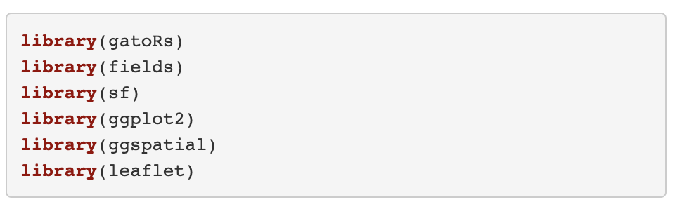
Load Packages
gatoRs custom package for processing biodiversity data
Geospatial packages include sf and fields
ggplot2, ggspatial, and leaflet are for visualization

Slide 5
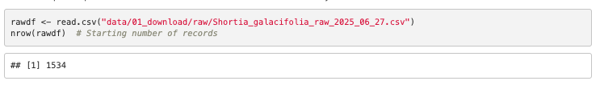
A. Load Data File
read.csv is a base function of R, it reads csv files
nrow print the number of rows

Slide 6
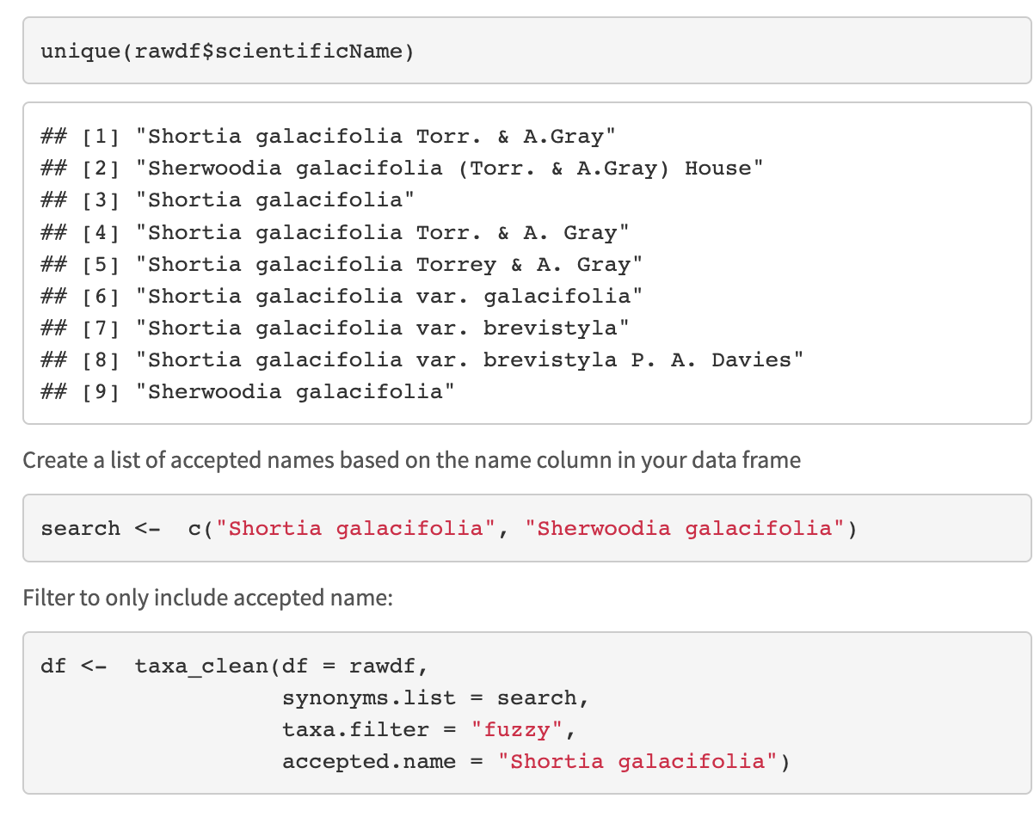
B. Taxonomic Harmonization
unique prints unique values in the column name from the dataframe rawdf.
c creates a list stored in the object search that contains “Shortia galacifolia” and “Sherwoodia galacifolia”

Slide 7
B. Taxonomic Harmonization
Here we are going to harmonize taxonomy using taxa_clean().
This function has three filter options: exact, fuzzy, or interactive.

Slide 8
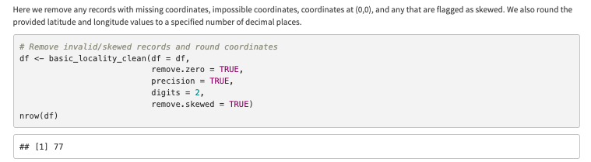
C. Locality Cleaning
basic_locality_clean() is from the package gatoRs

Slide 9
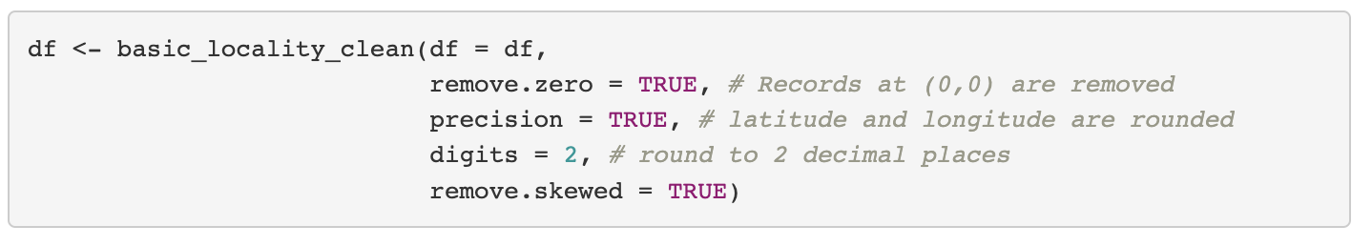
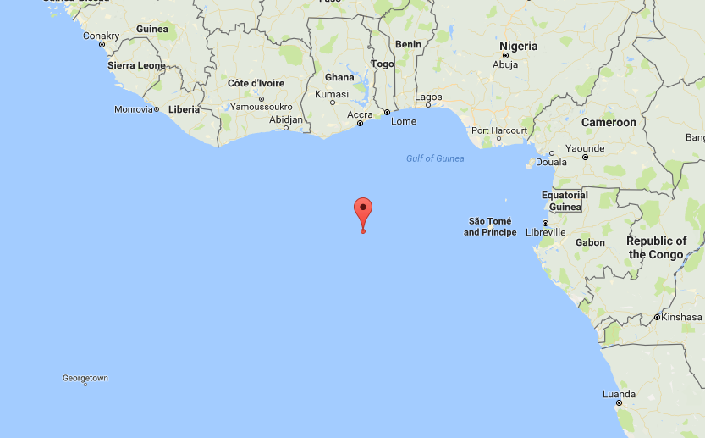
C. Locality Cleaning
Only retains records in the column long/lat that are not (!=) equal to 0.00
”There’s no place like 0,0”

Slide 10
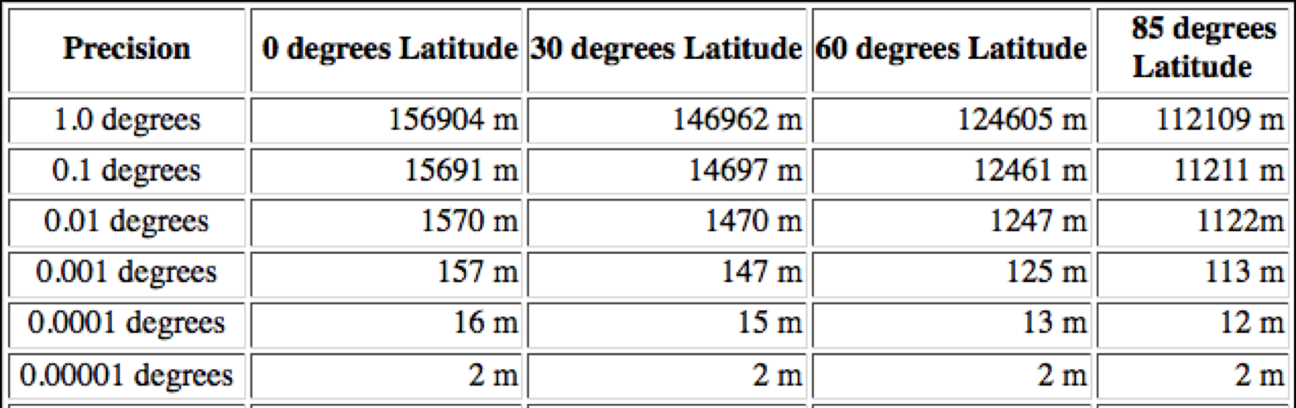
C. Locality Cleaning
Our climate layers are 30 arc-sec resolution which is about 1000 meters

Slide 11
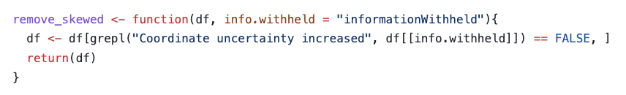
C. Locality Cleaning
The skewed records can be identified with based on the ‘InformationWitheld’ column.

Slide 12
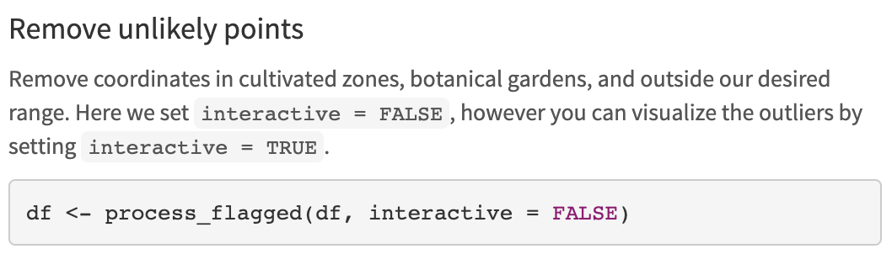
D. Flag and Filter Cultivated Records
Removes points in a radius
around biodiversity institutions
Zizka et al. 2019. CoordinateCleaner: Standardized cleaning of occurrence records from biological collection databases. Methods in Ecology and Evolution.

Slide 13
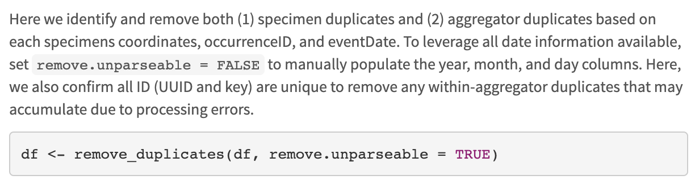
E. Duplicate Removal
parsedate is a beautiful package that parses dates – However, it only parses dates after 1970!
Try remove.unparable = FALSE

Slide 14
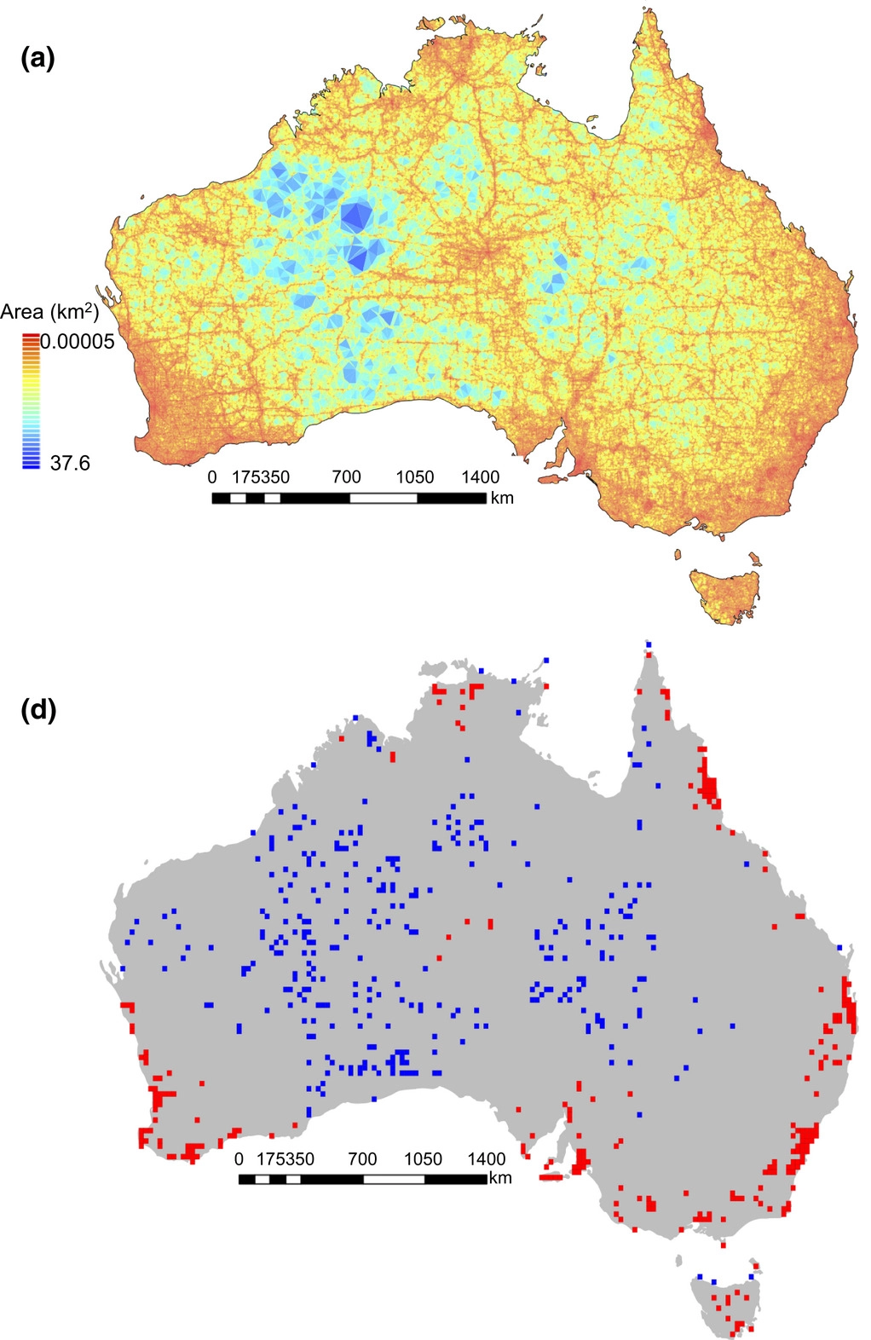
Sampling bias for
857,245 records
F/G. Spatial Deduplication and Thinning
Collection efforts can lead to clustering of points
Infrastructure (roads, herbaria, etc.)
Taxon bias
Temporal bias
Filtering is a procedure to reduce the clustering of species records
Collection efforts can lead to clustering of points
Daru et al. 2017. Widespread sampling biases in herbaria revealed from large-scale digitization. New Phytologist.
Notes:
Filtering is a procedure to reduce the clustering of species records .
Figure shows hotspots related to

Slide 15
F/G. Spatial Deduplication and Thinning
After filtering, there may still be spatial autocorrelation
This can be accounted for by data partitioning
Distance
Env. Similarity
Sillero N. and A. M. Barbosa. 2020. Common mistakes in ecological niche models. International Journal of Geographical Information Science.
Notes:
Filtering is a procedure to reduce the clustering of species records

Slide 16
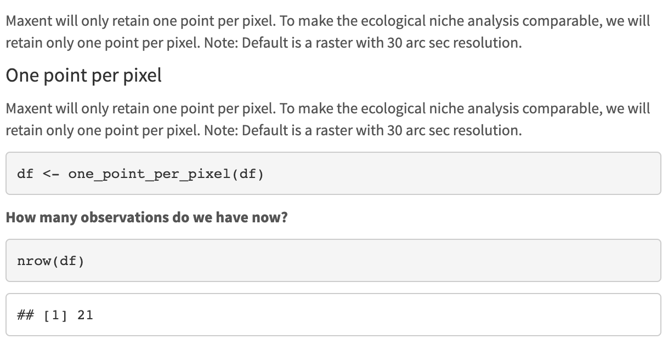
F. Spatial Deduplication
Notes:
Filtering is a procedure to reduce the clustering of species records

Slide 17
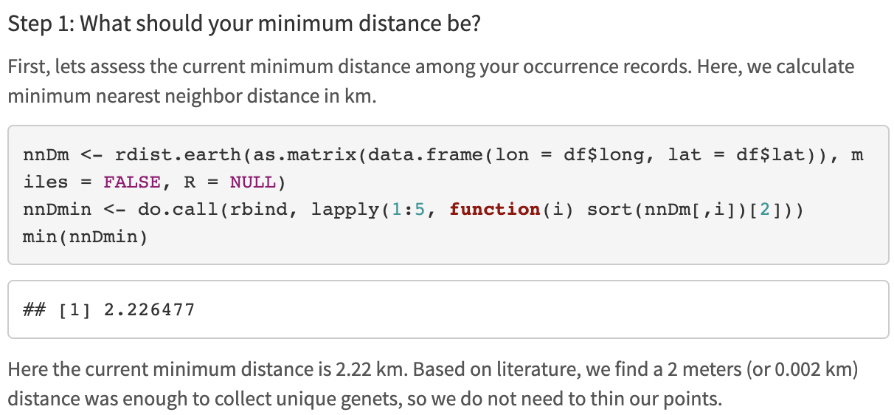
G. Spatial Thinning
rdist.earth can be used to look at nearest neighbor distance in kilometers
do.call applies to a list, rbind binds rows, and the sort is set up to select the lowest value.
We want to look at the min distance between points remaining

Slide 18
G. Spatial Thinning
spThin function thin
Set thin.par = minimum nearest neighbor distance
Next, the function calculates pairwise distance between all records
Then:
1) For each record, IDs the # of occurrence records within distance thin.par
2) One record of those which share the greatest # from (1) is removed at random.
3) Repeat 1 – 2 till no record has a nearest neighbor closer than thin.par
Aiello-Lammens et al. 2015. spThin: an R package for spatial thinning of species occurrence records for use in ecological niche models. Ecography.

Slide 19
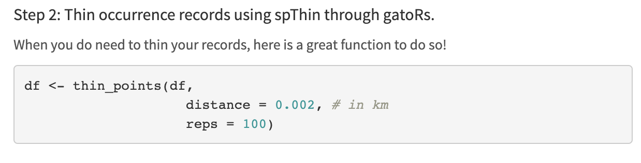
G. Spatial Thinning

Slide 20
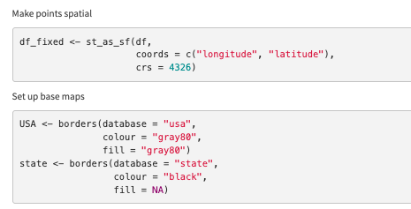
H. Static Map of Cleaned Points
crs = 4326 is WGS84
Using the function borders from the package ggplot2, we download basemaps to plot our points on.

Slide 21
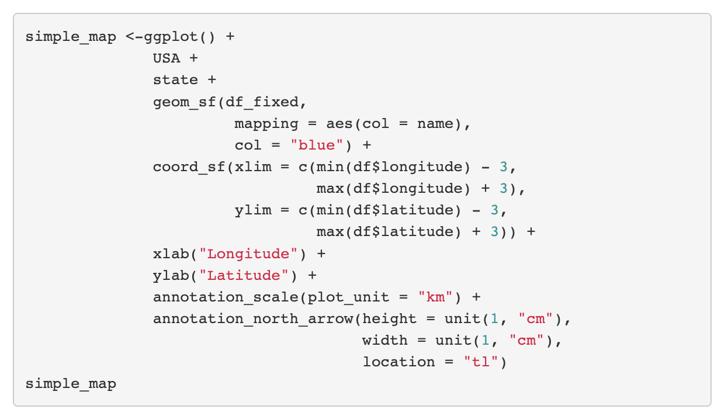
H. Static Map of Cleaned Points
1. Add basemaps
2. Add points
3. Zoom in
4. Fix axis labels
5. Add scale and North arrow

Slide 22
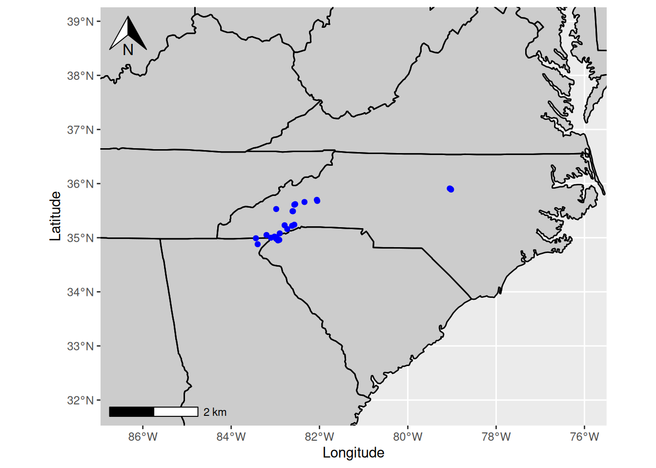
H. Static Map of Cleaned Points

Slide 23
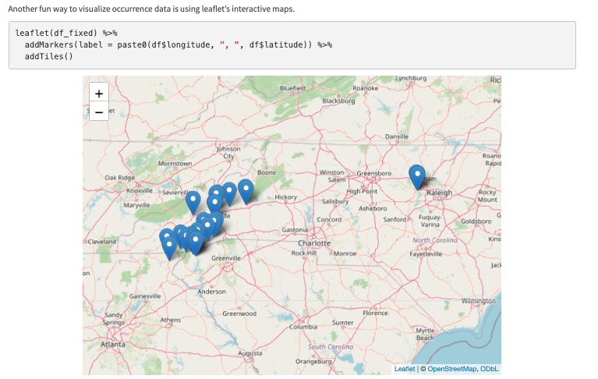
I. Interactive Map with Leaflet

Slide 24
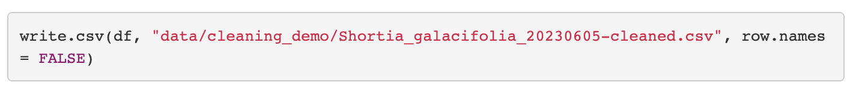
J. Saved Cleaned.csv

Slide 25
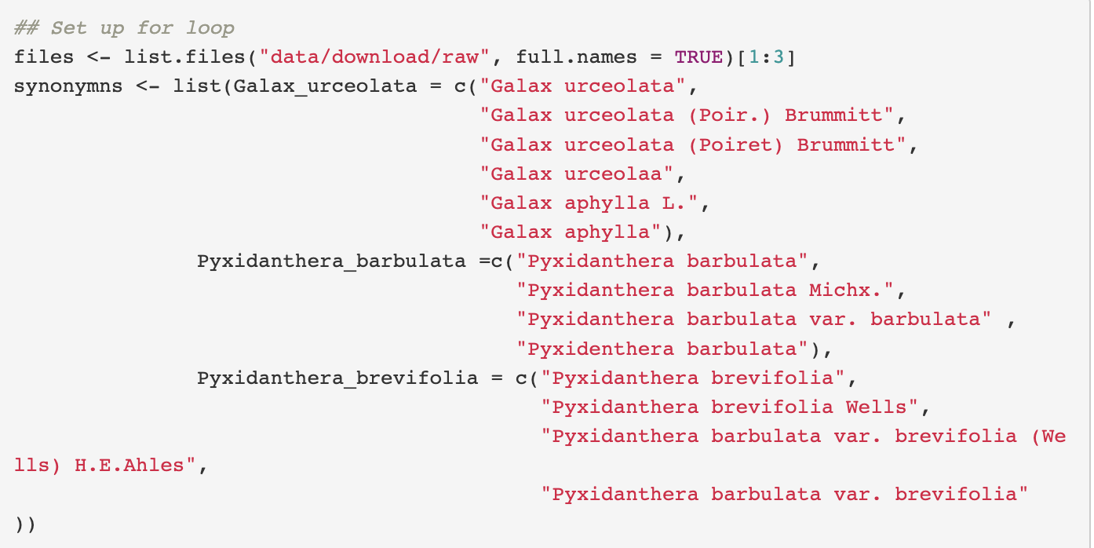
K. Repeat for all taxa
1. Create list of files with paths
2. Create list of synonyms

Slide 26
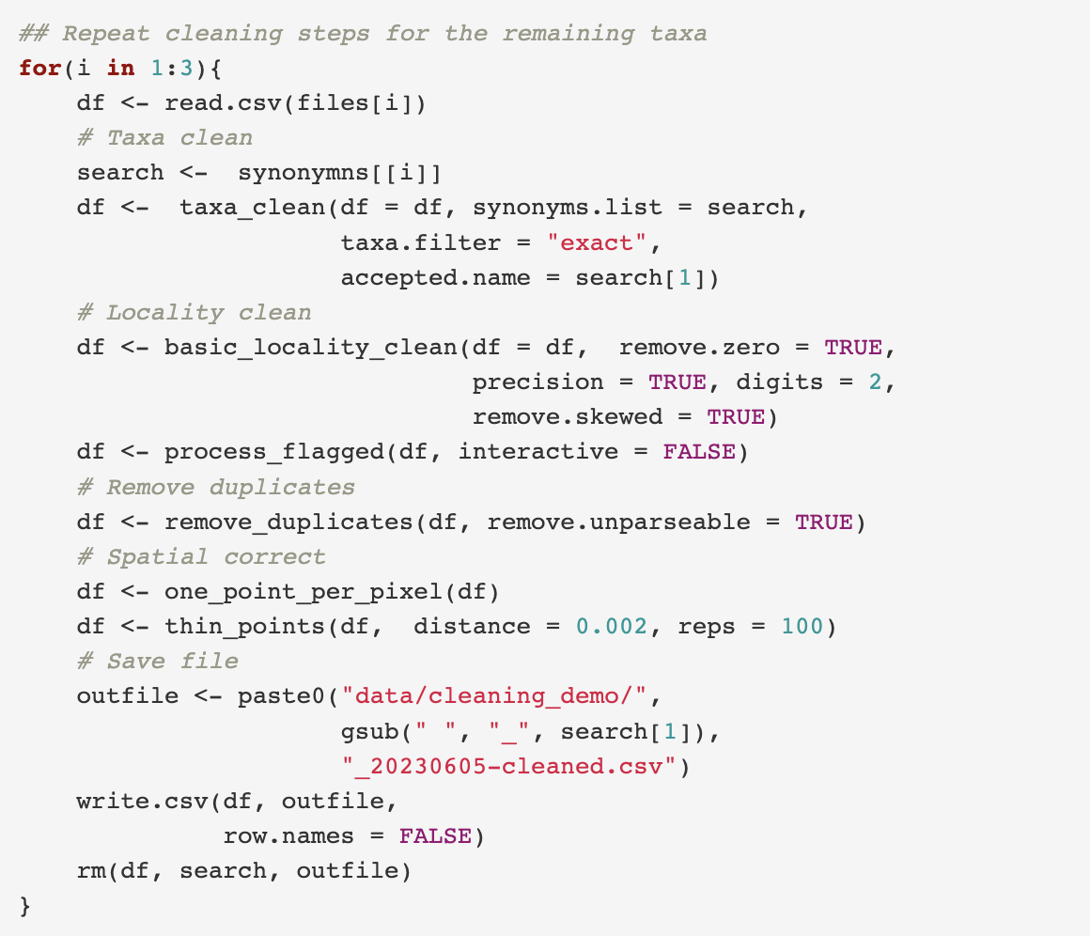
K. Repeat for all taxa
0. Read in downloaded data
Resolve taxon names
Clean localities
Precision
Remove impossible points
Most common coordinate: 0.00, 0.00
Cultivated zones, botanical gardens, ect.
Remove duplicates
Spatial correction
Visualize
Save cleaned.csv

Slide 27
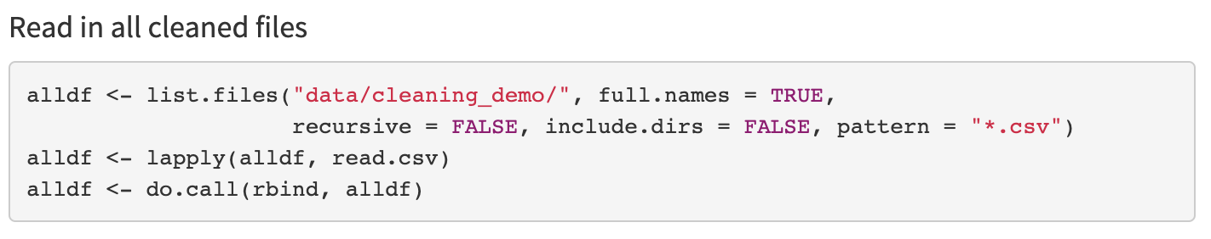
L. Make Maxent Ready

Slide 28
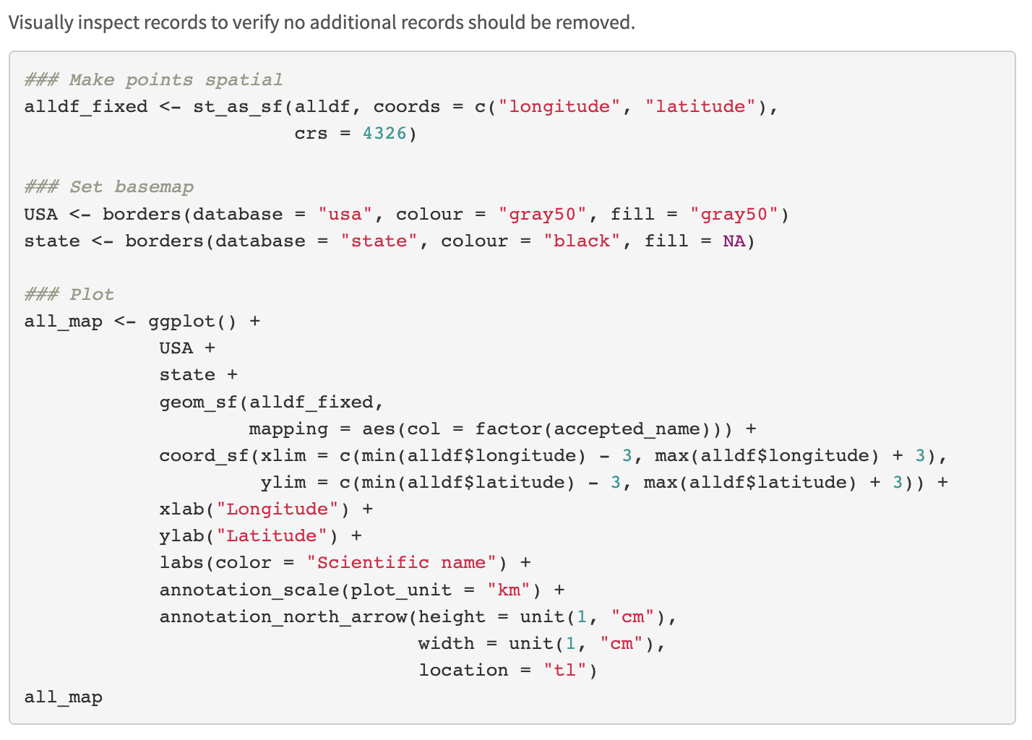
M. Map All Records

Slide 29
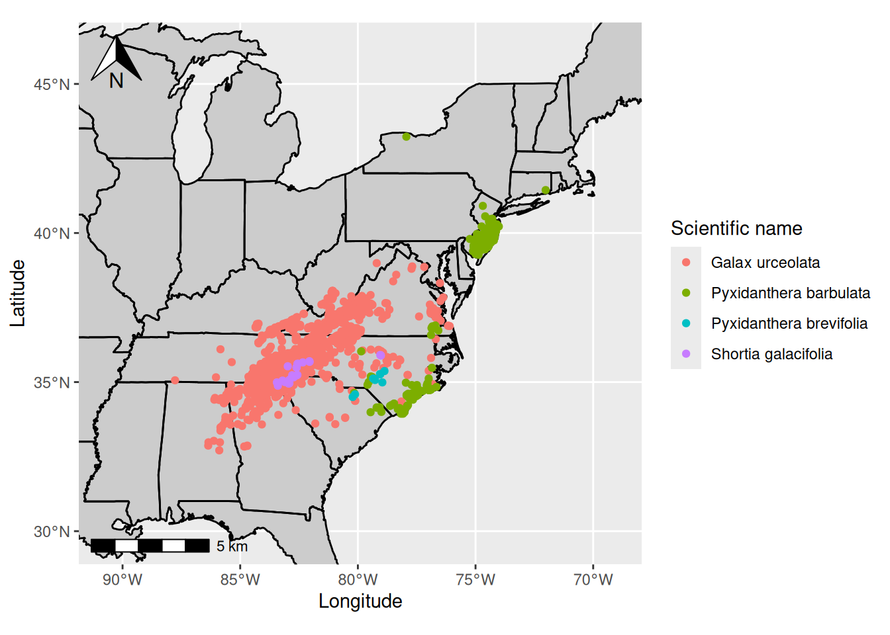

Slide 30
Minimum occurrence records
Your points should represent the env. variability true to your species.
Too few points may not classify your species suitable conditions properly.
It is not clear the minimum number of points needed.
Might be dependent on the extent of the study area
3, 4, or 5 have been suggested
5 per env. variable has also been suggested
More env. variables may not significantly change the minimum sample size needed (see study below).
Proosdij et al. 2016. Minimum required number of specimen records to develop accurate species distribution models. Ecography.

Slide 31
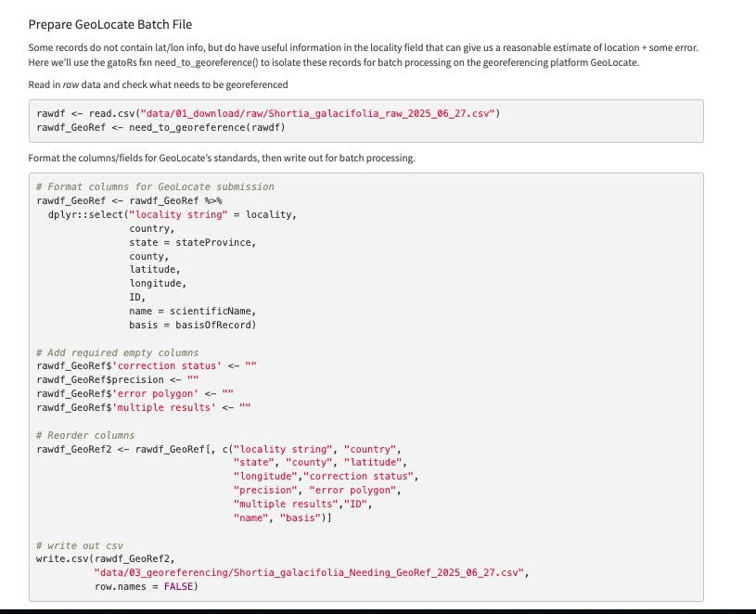
N. Georeferencing

